Slide 1
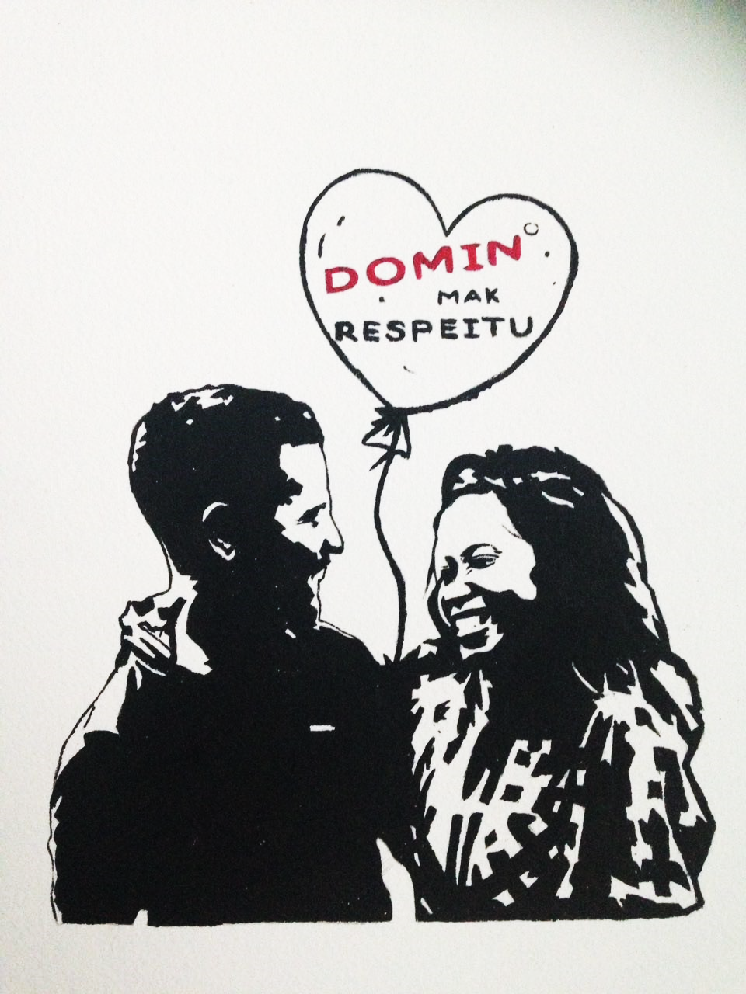
Training on Gender Equity and Violence Prevention
Cover artwork by Tony Amaral

Slide 2
Agenda
Introduction
Pre-test
Prevalence of violence in Timor-Leste
Common myths about violence against women
Understanding the root cause of violence against women
A model for prevention of violence
Victim-blaming
Evaluation

Slide 3
How common is violence against women in Timor-Leste?

Slide 4
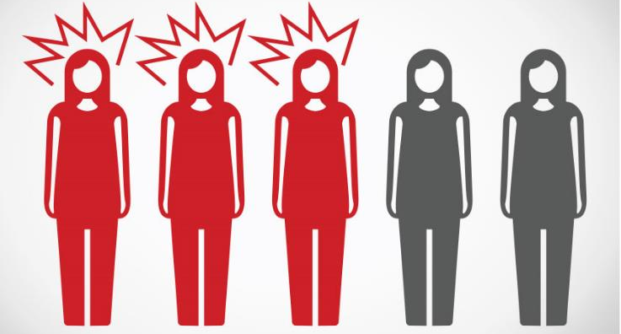
Intimate partner violence
Overall, three out of five (59%) ever-partnered women have been physically and/or sexually abused by their male partner (husband or boyfriend) in their life.
Experienced violence
Never experienced violence
Notes:
This violence was more common in urban areas than in rural areas and more common in the capital municipality, Dili, than in other municipalities. Women aged between 15-19 years were at the greatest risk of experiencing current physical and/or sexual partner violence, suggesting that violence often starts early in marriage.

Slide 5
How does this compare?
Lifetime
Last 12 months
Notes:
Lifetime prevalence of violence in Timor-Leste is similar to other Pacific islands and also Bangladesh. However, past-year experience prevalence is highest = women are not accessing services.

Slide 6
Non-partner rape
14% of women were ever raped by a man who was not their partner, and 10% in the past year.
3% of women were ever gang raped
Notes:
Comparison with other WHO data: highest levels were 10-12% in Peru, Samoa and Tanzania.
Men’s reported perpetration rates were much higher than women’s reported prevalence rates (possible shame for women and possible link to dominant masculine ideal for men): Non-partner rape lifetime: 15% in Dili and 22% in Manufahi. Current non-partner rape: 10% in Dili and 17% in Manufahi. Gang rape ever: 6% in Dili and 12% in Manufahi.

Slide 7
Any rape
Most rape, however, occurs within intimate relationships.
Notes:
More than one in three (34%) women surveyed had ever experienced any rape (either from a partner or non-partner) in their lifetime and 27% of women had experienced this in the last 12 months.
Men’s reported perpetration rates were much higher than women’s reported prevalence rates (possible shame for women and possible link to dominant masculine ideal for men): Non-partner rape lifetime: 15% in Dili and 22% in Manufahi. Current non-partner rape: 10% in Dili and 17% in Manufahi. Gang rape ever: 6% in Dili and 12% in Manufahi.

Slide 8
Common myths about violence against women in Timor-Leste

Slide 9
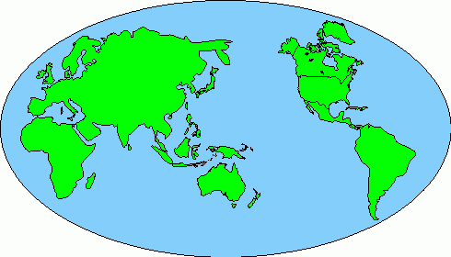
Where does violence occur?
Violence against women occurs in every country in the world.
Violence against women only occurs in developing countries OR is a foreign import.
Violence against women only occurs in developing countries OR is a foreign import.
Notes:
Mito: Violénsia hasoru feto akontese iha fatin balun de’it

Slide 10
What types of violence do women experience at home?
Sexual violence
There are multiple forms of violence against women and usually these overlap.
Physical violence
Economic violence
Emotional violence
Notes:
Mito: Mayoria feto sira hetan violénsia fízika deit.

Slide 11
How frequent are women’s experiences of violence in Timor-Leste?
In Timor-Leste, most women who have been abused by their husband or partner said that this abuse had occurred 3 times or more.
Notes:
This means that if a victim is encouraged/forced to return to live together with the perpetrator, this increases her risk of experiencing violence again.
Myth: most women experience violence only once or twice.
Feto na’in-4 iha kada feto na’in-5 (81%) ne'ebé hetan violénsia husi parseiru, hetan violénsia ne’e dala barak. Can occur as an isolated act but frequently a recurring, and often progressive, pattern of abusive behaviour

Slide 12
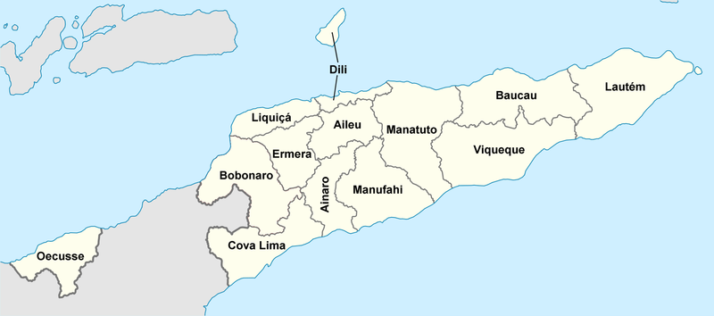
Is violence against women more common in rural or urban areas?
Violence against women occurs in all parts of Timor-Leste but it is most common in urban areas.
Violence against women usually happens in poor, rural areas.
Violence against women usually happens in poor, rural areas.
Notes:
Mito: Violénsia hasoru feto akontese iha area rural no area kiak de’it.

Slide 13
Do poor women experience more violence?
Women who earned a cash income were significantly more likely to experience violence, than women who didn’t earn cash.
DHS: Women in families with better economic situations have a higher probability of experiencing violence.
Notes:
Likely reason for this is that women who earn cash are challenging existing unequal
gender roles around women and the domestic sphere, and women’s decision-making powers.
As women gain more financial power, it can sometimes result in a backlash where men use
violence to reassert control within relationships. This does not imply that violence and gender
programing should not promote women’s economic empowerment, but rather that it needs
to work alongside broader efforts to transform inequitable gender relations. This includes
addressing dominant models of masculinity that emphasize men as breadwinners and other
restrictive gender norms.

Slide 14
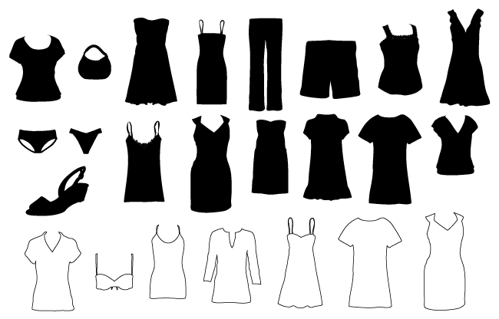
…but what was she wearing?
Sexual assault and harassment occur because some men decide to do it.
Commenting on the victim’s clothes places blame on her and removes his responsibility
Notes:
Myth: rape and sexual assault occur because of what a woman is wearing.

Slide 15
When the victim is a child
Due to the process of children’s psychological development, they can’t decide whether to marry or have sex.
All adults have a responsibility to protect child rights
Sex between a child (below 14) and an adult is always rape.
A girl and a boy cannot be married before they are both 17 (or before 16, with parental approval).
Notes:
Myth: If a man marries the girl that he raped then it’s not rape.
Early marriage is very common.
Child development is not very well understood.

Slide 16
How should cases of sexual assault be resolved?
Rape and sexual assault are public crimes and, therefore, must be reported to police.
If the family or community encourage the victim to marry the perpetrator, this increases her risk.
Notes:
Mito: Se vitima no mane ikus mai kaben, ne’e rezolusaun di’ak; Se mane selu kompensasaun ba vitima nia familia ne’e rezolusaun di’ak

Slide 17
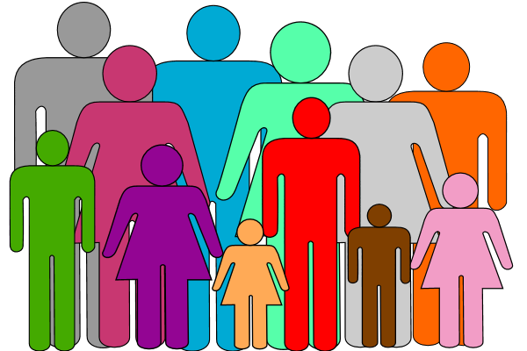
Who perpetrates rape?
Male intimate partners (husbands or boyfriends) are the main perpetrators of rape.
Usually women know the perpetrator (father or other family member, friend, neighbour)
?
Notes:
Mito: Iha maioria kazu violénsia, inkliu violasaun seksuál, vitima la hatene ka la koñese perpetradór

Slide 18
What does ‘public crime’ mean?
A ‘public crime’ is a crime that anyone can report to police.
A ‘public crime’ can happen in the home, at school, at church, in public, anywhere.
Eskola
Notes:
Violensia domestika mak krimi publiku. Krimi publiku tenke akontese iha fatin publiku ka lae?

Slide 19
What consequences do men experience after perpetrating rape?
Most men who perpetrate rape never experience any legal consequences.
Notes:
Mito: Maioria mane ne’ebe halo violasaun seksual kontra feto tama komarka.

Slide 20
Do all men use violence?
Many men do not use violence against women
Notes:
Mito: Mane hotu-hotu uza violénsia hasoru feto

Slide 21
Is violence preventable?
Violence against women is not something natural – this means that it is possible to prevent.
Past
Now
Future
Notes:
Mito: Husi tempu uluk to’o agora, violénsia hasoru feto sempre akontese, entaun violénsia hasoru feto ne’e buat natural, buat la bele muda

Slide 22
Cause of violence against women
The primary cause of violence against women is gender inequality.
Violence against women is violence that a woman experiences because she is a woman.
Women experience significantly more violence from men than men experience from women.
Notes:
Mito: Violénsia hasoru feto akontese prinsipálmente tanba feto sira nia hahalok

Slide 23
Power Walk

Slide 24
What is the cause of violence against women?

Slide 25
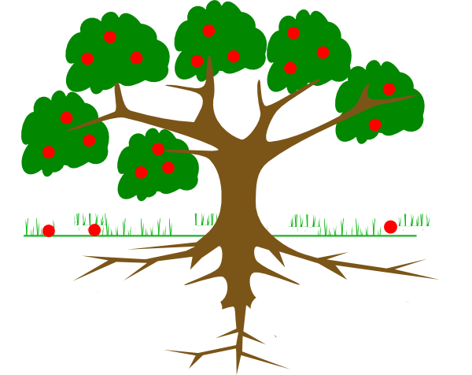
Violent act

Slide 26
Taking a woman’s money
insulting
shaming
Preventing a woman from working
intimidating
Forcing a woman to have sex
controlling
pushing
Having sex with a woman when she is too drunk or drugged to say no
kicking
pulling hair
Unwanted sexual touching
punching
slapping
Physical violence
Emotional violence
Economic violence
Sexual violence

Slide 27
Violent act
Factors that contribute to violence
Cause

Slide 28
Factors that contribute to violence
alcohol
drugs
stress
arguing
financial problems
anger
victim’s behaviour

Slide 29
Factors that contribute to violence

Slide 30
Factors that contribute to violence

Slide 31
Cause
Inequality between women and men

Slide 32
Other people‘s silence or inaction
Community attitudes
Social environment

Slide 33
Promotion of violence through media
Other people‘s silence or inaction
Community attitudes
Men need to be aggressive
Jokes about women
Victim-blaming
Justifying violence
Social environment

Slide 36
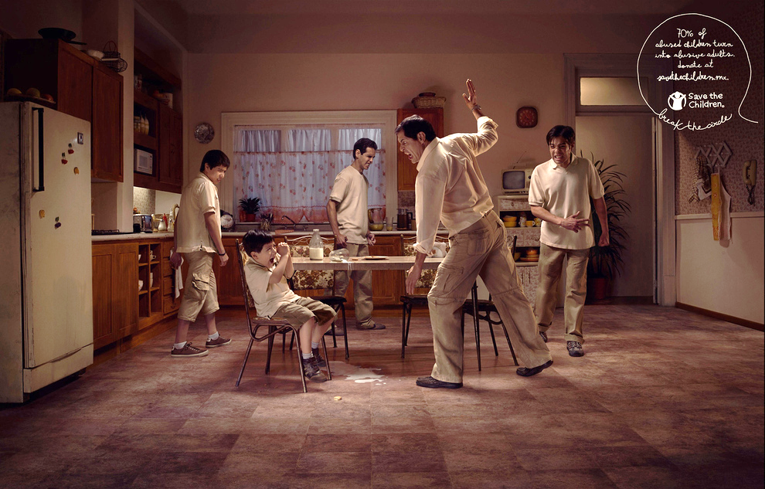
Notes:
Violence against women is learned behaviour:
learned through observation
learned through personal experience
learned in culture
learned in family
learned in communities, schools, friends, etc.

Slide 37
How can we better understand violence against women?
Notes:
Power Walk optional here

Slide 38
Ecological model to understand violence against women
INEQUALITY BETWEEN MEN AND WOMEN
Societal/
Institutional
Community
Family
Individual

Slide 39
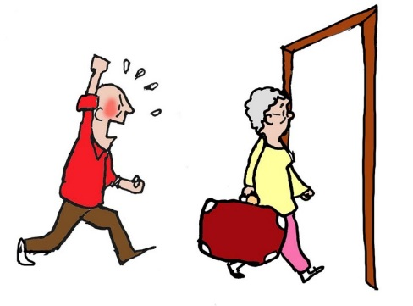
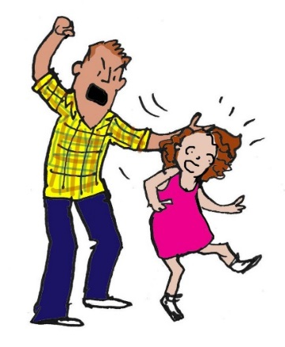
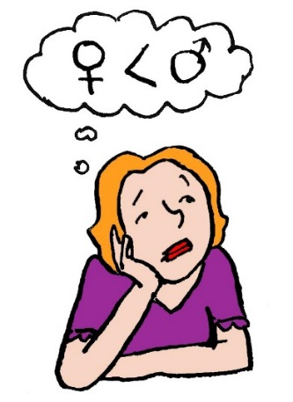
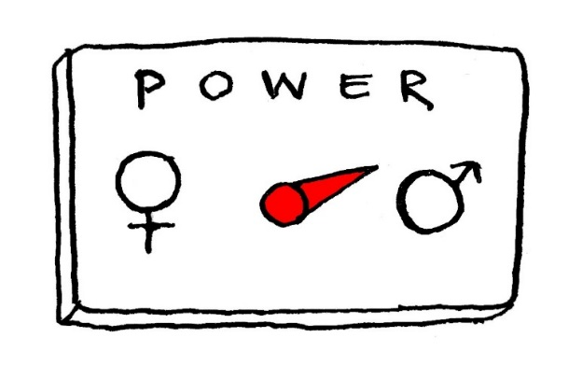
Ecological model to understand violence against women
Individual: dominant masculinity and subordinate femininity
Societal/
Institutional
Community
Family
Images from:
Imajen husi:
Individual
Notes:
Men use of violence, women accept this as normal, shame, victims bears responsibility…

Slide 40
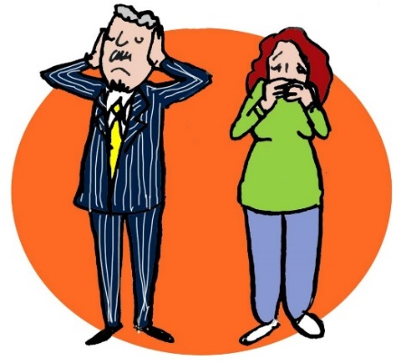
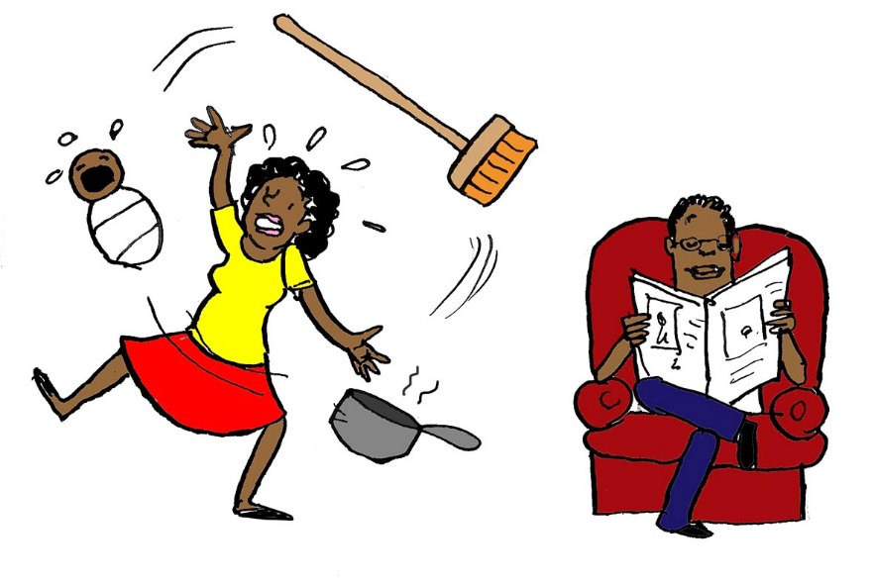
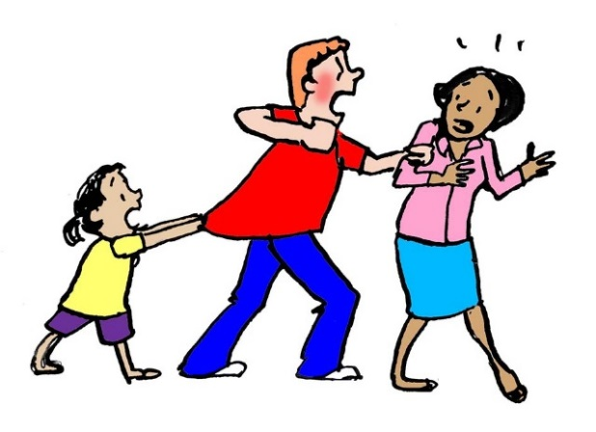
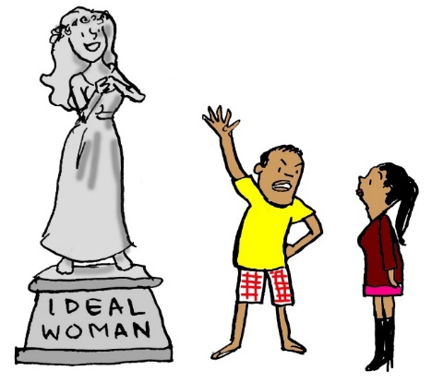
Ecological model to understand violence against women
Family: lack of family support, housework, expectations, children
Societal/
Institutional
Community
Family
Images from:
Imajen husi:
Individual
Notes:
Open support for vaw, acceptance of vaw, high conflict in relationships,…lack of family support for victims

Slide 41
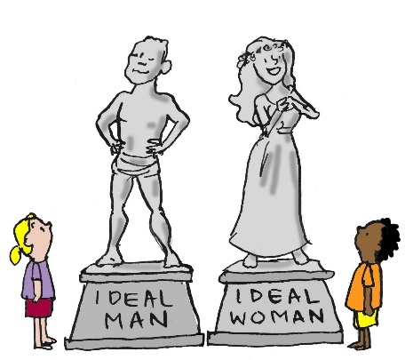
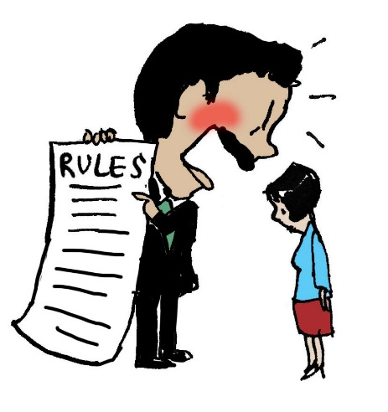
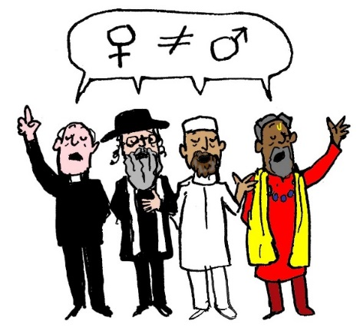
Ecological model to understand violence against women
Community: inequitable practices and norms
Societal/
Institutional
Community
Family
Images from:
Imajen husi:
Individual
Notes:
Atitude sosiál ne'ebé simu/tolera violénsia hasoru feto. Lack of response from justice sector and health, people don’t intervene, excuses, community violence…

Slide 42
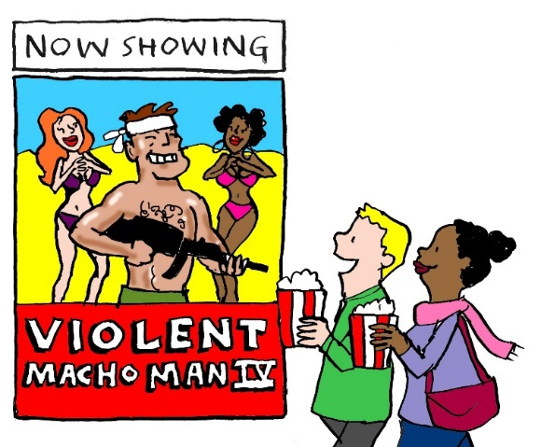
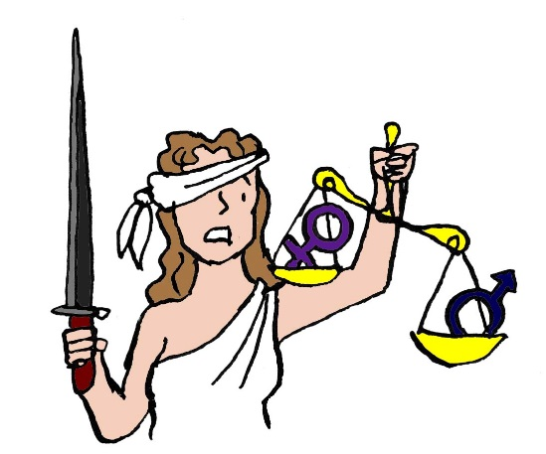
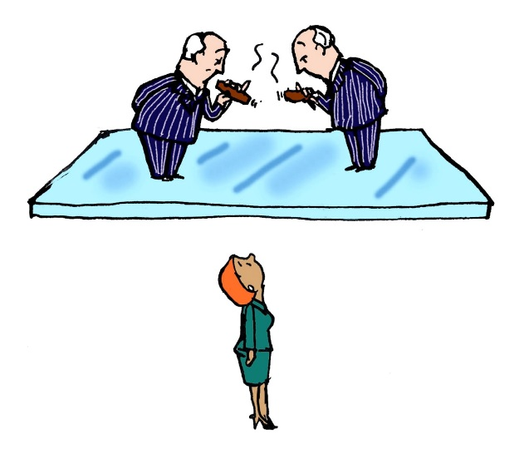
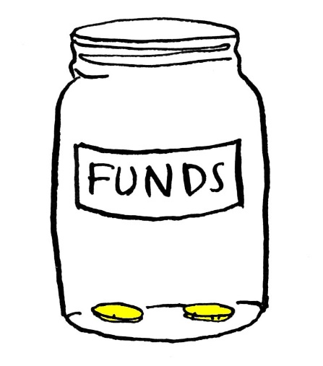
Ecological model to understand violence against women
Societal/Institutional: discriminative laws and policies
Societal/
Institutional
Community
Family
Images from:
Imajen husi:
Individual
Notes:
Deprioritizing of VAW, denial, dominance of male leadership, lack of political will, lack of funding, laws not implemented

Slide 43
How can we better understand how to prevent violence against women?

Slide 44
Using the Ecological Model to understand prevention
EQUALITY BETWEEN MEN AND WOMEN
Individual
Family
Community
Societal/
Institutional
Notes:
Individual: Make a personal commitment to take a stand against violence; Reflect on your own use of power in relationships; Report violence that you experience or witness; Inform yourself about referral services
Interpersonal: Promote equitable and respectful relationships; Support skills-building in non-violent communication in relationships; Promote nurturing, violence-free family environments; Family and close friends are supportive of victims, and intervene to stop violence in their family.
Community: Change community norms around acceptance of violence; Provide a supportive and non-judgmental environment for women to report; Provide nurturing, violence-free school environments; Support community-led initiatives to end violence against women
Social: Build social norms to enable gender equity; Strengthen legal sector response; Transform social gender norms to promote non-violent masculinities; Increase funding and capacity of health sector response; Secure cross-sectoral political will to address violence against women; Enact comprehensive sexual education curriculum focused on consent and respect

Slide 45
What can you, as an individual, do to prevent violence against women?
Individual
Family
Community
Societal/
Institutional
Notes:
Learn about the Rede Referal process and the phone numbers in my District so that I am ready to provide advice to anyone who needs it
Respect women and men equally
Be aware of my own behaviour

Slide 46
What can you, as a member of a family, do to prevent violence against women?
?
Individual
Family
Community
Societal/
Institutional
Notes:
Treat everyone in my family the same, regardless of gender
Never use violence in my family, no matter what the context is
Make a roster to share housework in my family
Make decisions together with my wife/husband
Speak out if my family members say or do something that promotes inequality or violence

Slide 47
What can you, as a community member, do to prevent violence against women?
Individual
Family
Community
Societal/
Institutional
Notes:
Organise community discussions about gender equality
Speak out when I hear/know about violence in my community
Make sure that the Rede Referal information is clearly posted in a public location in my suku

Slide 48
What can you, as a member of a society or a citizen of a country, do to prevent violence against women?
Individual
Family
Community
Societal/
Institutional
Notes:
Iha elesaun, bele vota ba kandidatu ne’ebe soporta politika di’ak ba igualdade jeneru
Halo advokasia ba gobiernu atu aloka fondos barak liu ba soporta vitima husi violensia
Halo advokasia ba seitor judisial atu aumenta implementasaun lei
Partisipa iha atividade sira kona-ba prevensaun violensia iha publiku

Slide 49
How are the words we use important?

Slide 50
Example: Sika and Paulino

Slide 51
Example: Sika and Paulino
“Paulino beat Sika.”
Who is at fault?
Notes:
Sentence is written in active voice. It is clear who is committing the violence.

Slide 52
Example: Sika and Paulino
“Sika was beaten by Paulino.”
Who is at fault?
Notes:
The sentence has been changed to passive voice, so Sica comes first.

Slide 53
Example: Sika and Paulino
“Sika was beaten.”
Who is at fault?
Notes:
Paulino is removed from the sentence entirely.

Slide 54
Example: Sika and Paulino
“Sika is a battered woman.”
Who is at fault?
VICTIM
Notes:
Being a victim is now part of Sika’s identity and Paulino is not part of the statement.

Slide 55
Example: Sika and Paulino
Sika has brought so many problems to our community
Sika must have provoked Paulino to beat her
Mana Sika deserved to be beaten
VICTIM
BLAME
Next time she should just be quiet
Sé mak sala?

Slide 56
Sika must have provoked Paulino to beat her.
Yeah. Actually, my wife always provokes me to use violence too.
SOCIAL ENVIRONMENT in which victims are responsible for violence, not perpetrators
Women need to control their emotions to avoid being beaten.
Notes:
Kuandu ita uza lia fuan ne’ebe sujere katak violénsia hasoru feto ne’e akontese tanba feto nia sala, ida ne’e kontribui ba desigualdade jeneru, no ba subordinasaun feto, entaun bele kontribui ba ambiente ne’ebe halo violénsia hasoru feto sai hanesan buat ne’ebe aseitavel

Slide 57
Maun Paulino was wrong to use violence against Mana Sika.
Yeah. Real men don’t beat women.
SOCIAL ENVIRONMENT where perpetrators are responsible for violence but all are responsible for prevention
Men have a responsibility to respect women and children.
Notes:
Kuandu ita uza lia fuan ne’ebe sujere katak violénsia hasoru feto ne’e akontese tanba feto nia sala, ida ne’e kontribui ba desigualdade jeneru, no ba subordinasaun feto, entaun bele kontribui ba ambiente ne’ebe halo violénsia hasoru feto sai hanesan buat ne’ebe aseitavel

Slide 58
Example from Timor-Leste
“Jose beat his wife, Maria, because Maria repeatedly asked Jose to wash the dishes and cook.”

Slide 59
Speak calmly to Maria
Try to understand Maria’s perspective
Breathe deeply
Go outside to calm down
Help Maria cook and wash dishes
Use violence
Notes:
Fatores ne’ebe bele kontribui ba hamosu violénsia – fase bikan

Slide 60
insults
anger
arguing
stress
Repeatedly asking
beating
Childhood experiences of abuse
Norms about women and men’s gender roles in the home
Social norm that men should control women
Gender inequality
Notes:
Fatores ne’ebe bele kontribui ba hamosu violénsia

Slide 61
Making fun of men who wash dishes
Other people‘s silence or inaction
Victim-blaming
Social acceptance of violence
insults
anger
stress
beating
arguing
Repeatedly asking
Childhood experiences of abuse
Norms about women and men’s gender roles in the home
Social norm that men should control women
Gender inequality
Notes:
Fatores ne’ebe bele kontribui ba hamosu violénsia

Slide 62
Notes:
Fatores ne’ebe bele kontribui ba hamosu violénsia

Slide 63
Example from Timor-Leste
“Jose beat his wife, Maria, because Maria repeatedly asked Jose to wash the dishes and cook.”
Who is the perpetrator?
If using this phrase, who is responsible for the violence?
What type of social environment does this phrase support?
If Maria asks Jose to cook and wash dishes, is that justification for him to beat her?
Is there another way to write this phrase?
Notes:
AMBIENTE SOSIAL ne’ebé vítima sira mak responsavel ba violensia, laos perpetrador
AMBIENTE SOSIAL ne’ebé perpetrador mak responsavel ba sira nia asaun no ita hotu mak responsavel ba prevensaun

Slide 64
Other options
“Maria repeatedly asked Jose to cook and wash the dishes but Jose didn’t want to help her. This time when she asked, Jose beat her.”
“Maria asked Jose to wash the dishes and cook but Jose didn’t want to and he beat Maria.”
“Jose beat Maria.”
Who is the perpetrator?
If using this phrase, who is responsible for the violence?

Slide 65
Example from report
“This physical violence occurred because the husband was suspicious that his wife was having an affair with another man.”

Slide 66
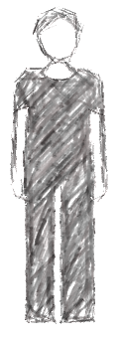
Example from report
“This physical violence occurred because the husband was suspicious that his wife was having an affair with another man.”
Who is at fault?
Notes:
If using ‘tanba’ that justifies the husband‘s actions.

Slide 67
Example from report
“The husband used physical violence against his wife.”
Who is at fault?

Slide 68
What else can you do?
If you hear or see someone you know blaming a victim of violence, for example by asking, ‘What was she wearing?’ or by saying ‘Well, she shouldn’t have burnt the food,’ tell them that those kinds of attitudes contribute to a society that excuses violence against women.
Remind them that the person responsible for violent actions is the perpetrator, not the victim. We, as members of a community, also have the responsibility to stand up against violence.

Slide 69
Small group discussion
Notes:
Praktika ho ezemplu husi TL

Slide 70
Small group discussion
Group 1: “Violence against women happens because of the Internet and social media, like Facebook.”
Do you agree with this statement? Why or why not?
According to this statement, what causes violence? Do you think that this is really the cause of violence, or is it a contributing factor, or neither?
If you hear a colleague, friend, or workshop participant make this statement, what can you do?
Group 2: “Women need to be patient so as not to provoke men into beating them.”
Do you agree with this statement? Why or why not?
According to this statement, who is at fault/who is responsible for the violence?
If you hear a colleague, friend, or workshop participant make this statement, what can you do?
Group 3: “Sexual violence occurs because young women go out to drink and hang out at discos.”
Do you agree with this statement? Why or why not?
According to this statement, who is at fault/who is responsible for the violence?
If you hear a colleague, friend, or workshop participant make this statement, what can you do?

Slide 71
Small group discussion
Group 4: “Men can’t control their behavior. To prevent sexual assault or harassment, women need to wear clothes that cover their bodies more.”
Do you agree with this statement? Why or why not?
According to this statement, who is at fault/who is responsible for the violence?
If you hear a colleague, friend, or workshop participant make this statement, what can you do?
Group 5: “If a man beats his wife but there is no blood, then this isn’t a public crime and there is no need to report it to the police.”
Do you agree with this statement? Why or why not?
What is the potential impact of this statement?
If you hear a colleague, friend, or workshop participant make this statement, what can you do?
Group 6: “The 14 year-old girl said that she wanted to have sex with the 20 year-old man because she loves him and has agreed to marry him, so that’s not violence.”
Do you agree with this statement? Why or why not?
According to this statement, who is at fault/who is responsible for the violence?
If you hear a colleague, friend, or workshop participant make this statement, what can you do?

Slide 72
Key points
There is a difference between the cause of violence and contributing factors
The root cause of violence against women is always gender inequality
Using violence against a woman is a decision that some men make
The words that we use are important and impactful

Slide 73
Key points
Through the way that we communicate we can contribute to gender inequality and subordination of women: factors that cause violence against women.
But we can also change the way we communicate in order to promote equality and respect: factors that can prevent violence against women.

Slide 74
